Slide 1
Advanced Data Structure and Algorithms
Trees
Graphs
Hashing
Search trees, Indexing, and multiways trees
File Organization

Slide 2
UNIT II GRAPHS
Important non-linear data structures
Airline/Railway Routes
Flowcharts
Road Maps
Computer Networks

Slide 3
Contents
Basic concepts
Operations on Graph
Graph Storage Structures
Traversals
Depth First Search
Breadth First Search
Graph Algorithms
Graph as ADT
Minimum Spanning Trees
Kruskal’s and Prims algorithm
Algorithms for shortest path and topological sorting.

Slide 4
Basic concepts
A graph is collection of nodes called Vertices and collection of segments called Lines.
Graph G={V,E}
Graphs
Directed Graph- Each Line has a direction [ARC]
Undirected Graph- No direction on any line[edges]
Path is a sequence of vertices in which each vertex is adjacent to next one.
Adjacent vertices if there is a path of length 1 connecting them.

Slide 5
Continued….
Cycle is a path consisting of at least 3 vertices that starts and ends with the same vertex.
Loop is special case of cycle in which a single arc begins and ends with the same vertex.
2 vertices are said to be connected if there is path between them.
Graph is said to be connected when there is path from any vertex to every other vertex.
Strongly connected
Weakly connected
Disjoint Graph
Degree of a vertex

Slide 6
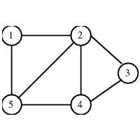
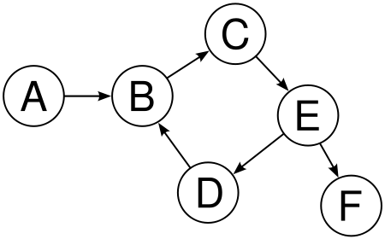
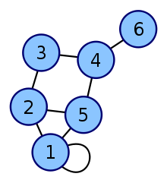
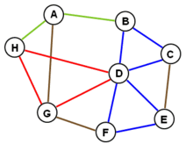
Undirected Graph
Directed Graph
(the edges are bidirectional)
(the edges point in a direction)
Cycle in Graphs
Loop in Graphs

Slide 7
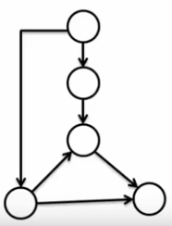
A
Weakly Connected Graphs
B
E
G
F
C
D
H
I
A directed graph in which it is possible to reach any node starting from any other node by traversing edges in some direction.
The nodes cannot be visited by a single path.
All components/nodes are connected by some path, ignoring direction.
A directed graph is weakly connected if the graph is not strongly connected, but the underlying undirected graph (i.e., considering all edges as undirected) is connected.

Slide 8
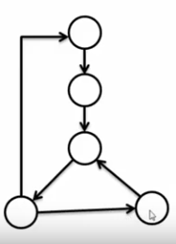
A
Strongly Connected Graphs
B
E
G
F
C
D
H
I
A directed graph in which, for every vertex v in the graph, there is a path from v to every other vertex.
The nodes can be visited by a single path.

Slide 9
A
Disjoint Graphs
B
E
G
F
C
D
H
I
Two subgraphs are edge disjoint if they share no edges, and vertex disjoint if they share no vertices.

Slide 10
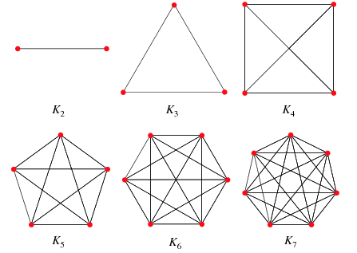
Complete Graph (Fully connected Graph)
A complete graph is a graph in which each pair of graph vertices is connected by an edge.
The complete graph with n graph vertices is denoted as K_{n} and has
n(n-1)/2 (the triangular numbers) undirected edges

Slide 11
Degree of vertex and graph
The degree of a vertex in a graph is its number of incident edges.
The maximum degree of a graph G is the maximum of the degrees of its vertices, denoted as ∆(G)
The minimum degree of G is the minimum of its vertex degrees; denoted as δ(G)
The total degree is the sum of the degrees of all vertices.
The degree sequence is the collection of degrees of all vertices, in sorted order from largest to smallest.
In a directed graph, one may distinguish the in-degree (number of incoming edges) and out-degree (number of outgoing edges)

Slide 12
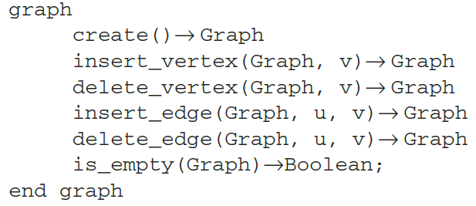
Operations on Graphs
Primitive graph operations
Insert a vertex
Delete a vertex
Add an edge
Delete an edge
Find a vertex
Traverse a graph
The graph ADT

Slide 13
Continued..
1. Insert Vertex:
adds new vertex to graph
When it is inserted it is disjoint
A
C
A
C
Insert Vertex
B
B
D
D

Slide 14
Continued..
2. Delete Vertex:
Removes vertex from graph
When it is removed all connecting edges are also removed
A
C
A
C
Delete Vertex
B
D
B
D

Slide 15
Continued..
3. Add Edge:
adds edge connects vertex to a destination vertex
A
C
A
C
Add Edge
B
D
B
D

Slide 16
Continued..
4. Delete Edge:
Delete edge from graph
A
C
A
C
Delete Edge
B
D
B
D

Slide 17
Continued..
5.Find Vertex
Traverse Graph looking for a specified vertex.
A
C
A
C
Find Vertex
B
D
B
D

Slide 18
Storage Structure of a Graph
‹#›
Adjacency-list representation of a graph G = ( V, E ) consists of an array ADJ of |V | lists, one for each vertex in V. For each u ∈ V , ADJ [ u ] points to all its adjacent vertices.
1
2
5
1
2
2
1
5
3
4
3
3
2
4
5
4
4
2
5
3
5
4
1
2
Linked Representation

Slide 19
Adjacency-list representation for a directed graph.
‹#›
1
2
5
1
2
2
5
3
4
3
3
4
5
4
4
5
5
5

Slide 20
Adjacency lists
‹#›
Advantage:
Saves space for sparse graphs. Most graphs are sparse.
Traverse all the edges that start at v, in θ(degree(v))
Disadvantage:
Check for existence of an edge (v, u) in worst case time θ(degree(v))

Slide 21
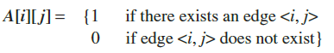
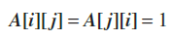
Adjacency-matrix-representation (sequential representation)
‹#›
Matrix representation of a graph G = ( V, E ) is a | V | x | V | matrix A = ( a_{ij} ) such that -
a_{ij} = 1 if (i, j ) ∈ E & 0 otherwise
1
1 2 3 4 5
2
1
2
3
4
5
0 1 0 0 1
3
1 0 1 1 1
0 1 0 1 0
5
4
0 1 1 0 1
1 1 0 1 0
We arbitrarily uniquely assign the numbers 1, 2, . . . , | V | to each vertex.

Slide 22
Adjacency Matrix Representation for a Directed Graph
‹#›
1 2 3 4 5
1
2
1
2
3
4
5
0 1 0 0 1
0 0 1 1 1
3
0 0 0 1 0
5
0 0 0 0 1
4
0 0 0 0 0

Slide 23
Adjacency Matrix Representation
‹#›
Advantage:
Saves space for Dense graphs.
Check for existence of an edge in θ(1)
Disadvantage:
Traverse all the edges that start at v, in θ(|V|)

Slide 24
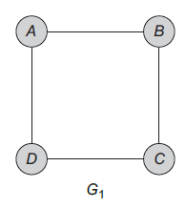
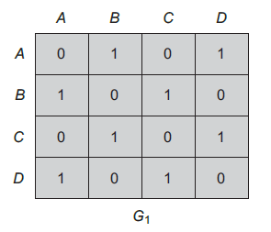
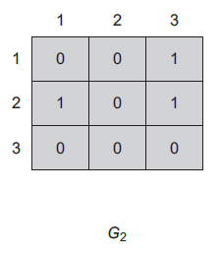
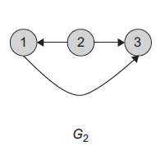

Slide 25
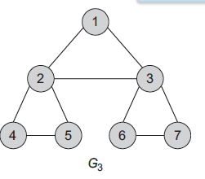
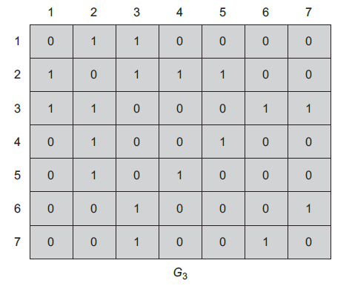

Slide 26
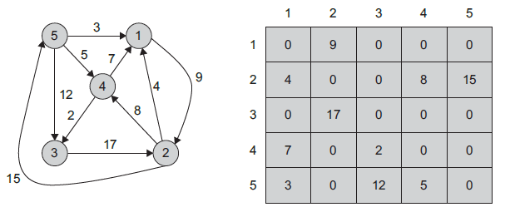
Adjacency Matrix Representation for weighted graph WEIGHTED graph is a TRIPLE (V, E, W)
‹#›
A[i][ j] = {weight if the edge <i, j> exists
0 if there exists no edge <i, j>}

Slide 27
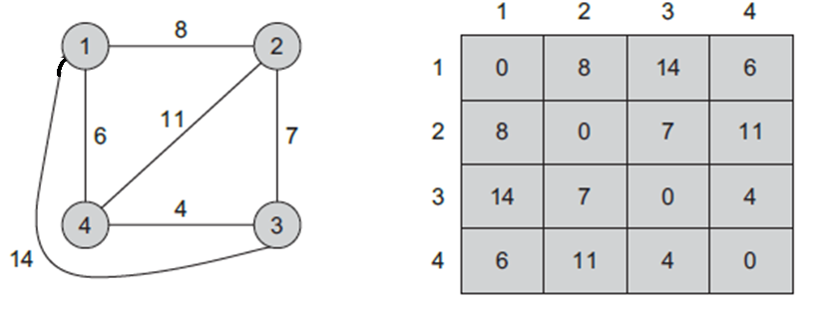
Adjacency Matrix Representation for weighted graph
‹#›
A[i][ j] = {weight if the edge <i, j> exists
0 if there exists no edge <i, j>}

Slide 28
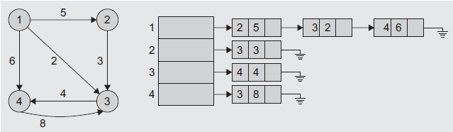
Adjacency List for weighted graph
Struct GraphNode
{
int vertex;
int weight;
GraphNode* next;
}
class GraphNode {
public:
int vertex;
int weight;
GraphNode* next;
GraphNode() {
vertex = weight = 0;
next = null;
}
};
OR
V W

Slide 29
Adjacency Multilists
An edge in an undirected graph is represented by two nodes in adjacency list representation.
For some applications, edge processing is done only once; this means we need to find other entries and mark them as processed – time consuming
Solution - Adjacency Multilists
lists in which nodes are shared among several lists. (an edge is shared by two different paths)
Node Structure :
one bit mark field that indicates whether or not the edge has been examined.
Processed vertex1 vertex2 path1 path2

Slide 30
Example for Adjacency Multlists
(1,0)
0
1
2
3
N1
N2
N3
N4
N5
N6
0 1 N2 N4
edge (0,1)
edge (0,2)
edge (0,3)
edge (1,2)
edge (1,3)
edge (2,3)
(2,0)
0 2 N3 N4
(3,0)
0 3 N5
(2,1)
0
1 2 N5 N6
(3,1)
1
2
1 3 N6
(3,2)
3
2 3
six edges
Lists: vertex 0: N1 → N2 → N3, vertex 1: N1 → N4 → N5
vertex 2: N2 → N4 → N6, vertex 3: N3 → N5 → N6

Slide 31
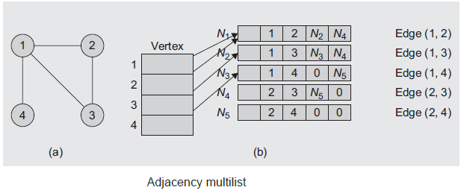
Example for Adjacency Multlists
Vertex 1: N1 → N2 → N3
Vertex 2: N1 → N4 → N5
Vertex 3: N2 → N5
Vertex 4: N3 → N5

Slide 32
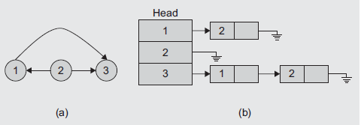
Inverse Adjacency lists
‹#›
An inverse adjacency list is a set of lists that contains one list for each vertex.
Each list contains a node per vertex adjacent to the vertex it represents (i.e. consider in-degree for a vertex)

Slide 33
Sequential Vs Linked representation
Linked Representation | Sequential Representation
Adjacency List representation | Adjacency matrix representation
Has an advantage of space complexity. | Requires an n x n matrix with n vertices, regardless of the number of edges. Needs more memory asymptotically.
Suitable for sparse graphs. The number of edges |E| is much lesser than V. Provides a compact way to represent the graph. | If the graph is sparse, many of the entries are null. Suitable for dense graph. |E| is closer to V

Slide 34
Sequential Vs Linked representation
Linked Representation | Sequential Representation
Does not provide direct access; Cannot quickly determine whether an edge between any two vertices is incident or not. | Provides direct access, it is suitable for many applications.
Check for existence of an edge (v, u) in worst case time θ(degree(v)) | Check for existence of an edge in θ(1)
Traverse all the edges that start at v, in θ(degree(v)) | Traverse all the edges that start at v, in θ(|V|)

Slide 35
Traversing Graphs (Processing a graph)
Traversal strategies - provide an efficient way to “visit” each vertex and edge exactly once.
Traversals are classified by the order in which the vertices are visited.
Traversal of a graph can be commonly used to search a vertex or an edge through the graph; hence, it is also called a search technique.
Two techniques –
Depth First Search (DFS)
Breadth First Search (BFS)

Slide 36
Depth First Search
Strategy : From the currently visited vertex in the graph, keep searching/visiting deeper.
i.e. all the vertices are visited by processing a vertex and its descendents before processing its adjacent vertices.
Execution:
First, push the first vertex say A into the stack.
Loop
Pop the stack
Process/visit the vertex i.e. print the vertex
Push all the adjacent vertices of A into the stack
End Loop // When the stack is empty
Traversal is complete.

Slide 37
Depth First Search
Strategy : From the currently visited vertex in the graph, keep searching/visiting deeper.
i.e. all the vertices are visited by processing a vertex and its descendents before processing its adjacent vertices.
Execution:
First, push the first vertex say A into the stack.
Loop
Pop the stack
Process/visit the vertex i.e. print the vertex
Push all the adjacent vertices of A into the stack
End Loop // When the stack is empty
Traversal is complete.

Slide 38
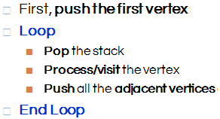
Graph Traversal [DFS]
1
A
A
X
H
P
E
Y
M
J
G
3
6
2
X
H
Y
5
E
8
7
9
G
P
M
J
4
A
P
E
G
X
H
G
E
G
Y
M
G
J
G

Slide 39
Graph Traversal [DFS]
1
A
A X H P E Y M J G
3
6
2
X
H
Y
5
E
8
7
9
G
P
M
J
4
A
P
E
G
X
H
G
E
G
Y
M
G
M
G
J
G
G

Slide 40
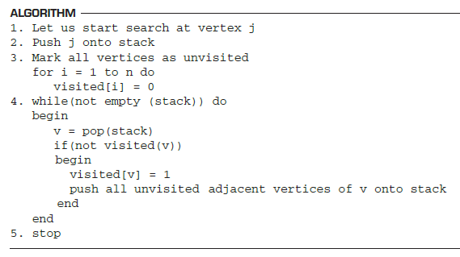
Depth First Search
Non-Recursive pseudo code-

Slide 41
Depth First Search
Non-Recursive pseudo code-

Slide 42
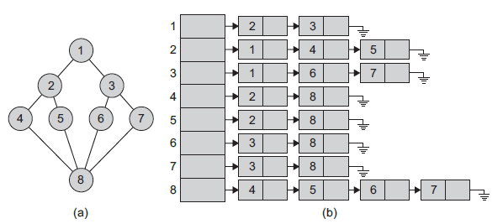
Depth First Search
OR
1, 2, 4, 8, 5, 6, 3, 7
1, 3, 7, 8, 6, 5, 2, 4

Slide 43
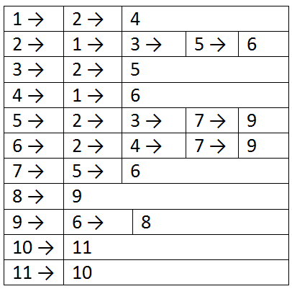
Depth-First Search Example
2
3
‹#›
8
1
4
5
9
10
6
7
11
Start search at vertex 1.
Start vertex 4
4 1 2 3 5 7 6 9 8
OUTPUT - 1 2 3 5 7 6 4 9 8

Slide 44
Time Complexity - DFS
‹#›
O(V + E) time is required by the DFS for adjacency list representation
O(V²) for adjacency matrix representation.
DFS is more faster than BFS.

Slide 45
Breadth First Search
Strategy : From the currently visited vertex in the graph, keep searching/visiting its breadth.
i.e. all the vertices are visited by processing a vertex and its adjacent vertices.
Execution:
First, Enqueue the first vertex say A into the queue.
Loop
Dequeue
Process/visit the vertex i.e. print the vertex
Enqueue all the adjacent vertices of A into the queue
End Loop // When the Queue is Not empty
Traversal is complete.

Slide 46
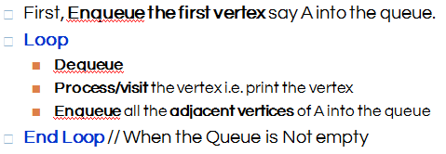
Graph Traversing [BFS]
1
A
A
X
G
H
P
E
M
Y
J
4
8
2
X
H
Y
6
E
9
7
3
G
P
M
J
5
X
G | H
H | P
P | E
M | Y
A
J
Queue Empty

Slide 47
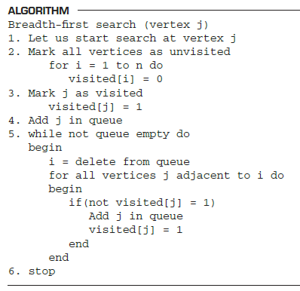
Breadth First Search Non-Recursive pseudo code

Slide 48
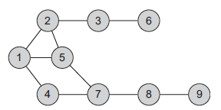
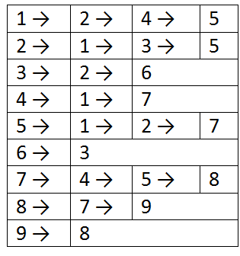
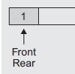
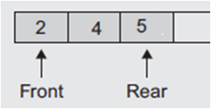
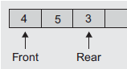
Breadth-First Search Example
‹#›
Start search at vertex 1.
Output - 1 2 4 5 3 7 6 8 9
…………

Slide 49
Breadth-First Search Example
‹#›
2
3
8
1
4
5
9
10
6
7
11
Start search at vertex 1.
Output – 1 2 4 3 5 6 7 9 8

Slide 50
Time Complexity - BFS
‹#›
Each visited vertex is put on (and so removed from) the queue exactly once.
When a vertex is removed from the queue, we examine its adjacent vertices.
O(vertex degree) time is required by the BFS for adjacency list representation
O(V²) for adjacency matrix representation.
BFS takes up a lot of space.

Slide 51
DFS and BFS
‹#›
DFS stores only one adjacent vertex pointer.
Faster
Uses backtracking
Time complexity –
O(V²) for matrix
O(V + E) for List
BFS stores all adjacent vertex pointers.
Slower
No backtracking
Time complexity –
O(V²) for matrix
O(vertex degree) for List

Slide 52
Applications—Communication Network
2
3
8
1
10
4
5
9
11
6
7
Vertex = city, edge = communication link.

Slide 53
Driving Distance/Time Map
2
4
3
8
8
1
6
10
2
4
5
4
4
3
5
9
11
5
6
6
7
7
Vertex = city,
edge weight = driving distance/time.

Slide 54
Street Map
2
3
8
1
10
4
5
9
11
6
7
Some streets are one way.

Slide 55
Spanning Tree
A Tree is a connected graph with no cycles.
Spanning Tree of a graph is a sub graph that contains all the vertices and it is a Tree.
Graph may have many Spanning Trees.
Graph A
Some Spanning Trees from Graph A
or
or
or

Slide 56
Complete Graph
All 16 of its Spanning Trees

Slide 57
Minimum Spanning Trees
The Minimum Spanning Tree for a given graph is the Spanning Tree of minimum cost for that graph.
Complete Graph
Minimum Spanning Tree
7
2
2
5
3
3
4
1
1
Application –
Finding the least amount of wire needed to connect a group of computers, houses, or cities.

Slide 58
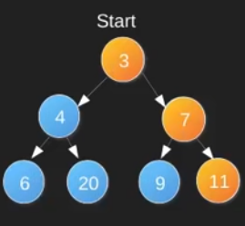
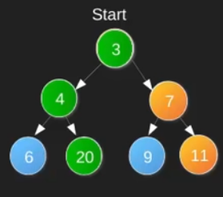


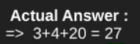
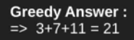
Greedy Strategy
An algorithmic paradigm that follows the problem solving approach of making the locally optimal choice at each stage with the hope of finding a global optimum (best solution).
Add largest value or smallest value as per the application.
Simple, easy to implement, and runs fast.
Sometimes may not provide the best solution.
Largest root to leaf sum

Slide 59
Greedy Strategy properties
Greedy choice property
A global optimum can be arrived at by selecting a local optimum.
Optimal substructure
An optimal solution to the problem contains an optimal solution to sub problems.
Applications
Huffman coding
Prim’s spanning tree

Slide 60
Algorithms for Minimum Spanning Tree
Kruskal's Algorithm - J.B. Kruskal
Prim's Algorithm - R.C. Prim

Slide 61
Kruskal’s Algorithm
Graph G(V,E)
to
G' = (V', E’)
Sort edges in ascending order → Keep adding minimum weight edges with no cycle till all vertices are Processed (i.e # of edges in MST is less than # of vertices.
Algorithm -
Arrange the edges in an increasing order of their weights
V' = V and E' = ø, |V| = n and | E' | = 0 //same vertices; zero edges
While ( |E'| < (V-1) ) do
Begin
Find edge <u,v> of minimum length.
If <u,v> does not create a cycle in G' then
add <u,v> to G'
else
discard <u,v>
End
Stop

Slide 62
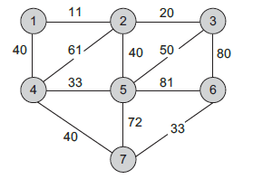
Kruskal’s Algorithm
EDGE
<1, 2>
<2, 3>
<4, 5>
<6, 7>
<1, 4>
<2, 5>
<4, 7>
<3, 5>
<2, 4>
<5, 7>
<3, 6>
<5, 6>
WEIGHT
11
20
33
33
40
40
40
50
61
72
80
81
Step 1 – Sort the edges
Initially, connected components are {1} {2} {3} {4} {5} {6} {7}

Slide 63
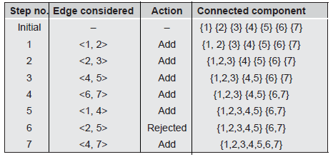
Kruskal’s Algorithm
EDGE
<1, 2>
<2, 3>
<4, 5>
<6, 7>
<1, 4>
<2, 5>
<4, 7>
<3, 5>
<2, 4>
<5, 7>
<3, 6>
<5, 6>
WT
11
20
33
33
40
40
40
50
61
72
80
81
Cost = 0
Cost = cost + weight of added edge

Slide 64
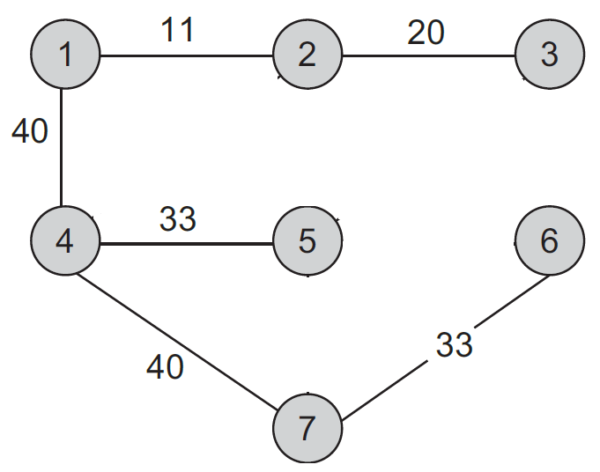
Kruskal’s Algorithm - MST
Kruskal’s use Union-Find algorithm to find smallest edge & add it to MST (incremental connection).
This minimum spanning tree has the cost as 177

Slide 65
4
1
Complete Graph
A
B
A
D
4
4
B
C
B
D
10
2
4
B
C
B
J
C
E
4
1
5
2
1
C
F
D
H
A
4
E
1
F
6
2
D
2
3
D
J
E
G
10
5
3
5
G
F
G
F
I
5
6
3
4
3
4
I
G
I
G
J
H
3
2
3
2
J
H
J
I
J

Slide 66
Sort Edges
(in reality they are placed in a priority queue - not sorted - but sorting them makes the algorithm easier to visualize)
1
1
A
D
C
F
2
2
C
E
E
G
4
2
3
B
C
H
J
F
G
4
2
1
3
3
G
I
I
J
A
4
E
1
F
4
4
D
2
3
A
B
B
D
10
5
4
4
G
B
C
G
J
5
6
3
4
5
5
I
F
I
D
H
H
2
3
6
10
J
D
J
B
J

Slide 67
1
1
Add Edge
A
D
C
F
2
2
C
E
E
G
2
3
B
4
C
H
J
F
G
4
3
3
2
1
G
I
I
J
A
4
E
1
F
4
4
D
2
3
A
B
B
D
10
4
4
G
5
B
C
G
J
5
6
3
5
5
4
I
F
I
D
H
H
10
3
6
2
J
D
J
B
J

Slide 68
1
1
Add Edge
A
D
C
F
2
2
C
E
E
G
2
3
B
4
C
H
J
F
G
4
2
1
3
3
G
I
I
J
A
4
E
1
F
4
4
D
2
3
A
B
B
D
10
G
5
4
4
B
C
G
J
5
6
3
4
5
5
I
F
I
D
H
H
3
6
10
2
J
D
J
B
J

Slide 69
1
1
Add Edge
A
D
C
F
2
2
C
E
E
G
2
3
B
4
C
H
J
F
G
4
2
3
3
1
G
I
I
J
A
4
E
1
F
4
4
D
2
3
A
B
B
D
10
4
4
G
5
B
C
G
J
5
6
3
5
5
4
I
F
I
D
H
H
6
10
2
3
J
D
J
B
J

Slide 70
1
1
Add Edge
A
D
C
F
2
2
C
E
E
G
2
3
B
4
C
H
J
F
G
4
2
3
1
3
G
I
I
J
A
4
E
1
F
4
4
D
2
3
A
B
B
D
10
4
G
5
4
B
C
G
J
5
6
3
4
5
5
I
F
I
D
H
H
3
6
10
2
J
D
J
B
J

Slide 71
1
1
Add Edge
A
D
C
F
2
2
C
E
E
G
2
3
B
4
C
H
J
F
G
4
3
3
2
1
G
I
I
J
A
1
4
E
F
4
4
D
2
3
A
B
B
D
10
4
4
G
5
B
C
G
J
5
6
3
5
5
4
I
F
I
D
H
H
10
3
6
2
J
D
J
B
J

Slide 72
1
1
Cycle
Don’t Add Edge
A
D
C
F
2
2
C
E
E
G
2
3
B
4
C
H
J
F
G
4
3
3
2
1
G
I
I
J
A
4
E
1
F
4
4
D
2
3
A
B
B
D
10
5
4
4
G
B
C
G
J
5
6
3
5
5
4
I
F
I
D
H
H
6
10
3
2
J
D
J
B
J

Slide 73
1
1
Add Edge
A
D
C
F
2
2
C
E
E
G
2
3
4
B
C
H
J
F
G
4
2
3
3
1
G
I
I
J
A
1
4
E
F
4
4
D
2
3
A
B
B
D
10
4
4
G
5
3
B
C
G
J
5
6
5
5
4
I
F
I
D
H
H
6
10
3
2
J
D
J
B
J

Slide 74
1
1
Add Edge
A
D
C
F
2
2
C
E
E
G
2
3
B
4
C
H
J
F
G
4
2
1
3
3
G
I
I
J
A
4
E
1
F
4
4
D
2
3
A
B
B
D
10
G
5
4
4
B
C
G
J
5
6
3
4
5
5
I
F
I
D
H
H
3
6
10
2
J
D
J
B
J

Slide 75
1
1
Add Edge
A
D
C
F
2
2
C
E
E
G
2
3
B
4
C
H
J
F
G
4
2
1
3
3
G
I
I
J
A
4
E
1
F
4
4
D
2
3
A
B
B
D
10
4
G
5
4
B
C
G
J
5
6
3
4
5
5
I
F
I
D
H
H
3
6
10
2
J
D
J
B
J

Slide 76
1
1
Cycle
Don’t Add Edge
A
D
C
F
2
2
C
E
E
G
2
3
4
4
B
C
H
J
F
G
2
3
3
1
G
I
I
J
A
4
E
1
F
4
4
D
2
3
A
B
B
D
10
4
G
5
4
B
C
G
J
5
6
3
5
5
4
I
F
I
D
H
H
6
10
3
2
J
D
J
B
J

Slide 77
1
1
Add Edge
A
D
C
F
2
2
C
E
E
G
4
2
3
4
B
C
H
J
F
G
2
3
3
1
G
I
I
J
A
4
E
1
F
4
4
D
2
3
A
B
B
D
10
4
4
G
5
3
B
C
G
J
5
6
5
5
4
I
F
I
D
H
H
6
10
3
2
J
D
J
B
J

Slide 78
Minimum Spanning Tree
Complete Graph
Cost = 22
4
4
B
C
4
B
C
4
4
B
C
4
2
2
1
1
2
1
A
4
A
4
E
E
F
A
1
F
1
E
1
F
2
D
2
3
2
D
3
D
10
10
5
G
5
G
G
5
6
3
5
6
3
4
4
I
I
I
H
H
H
3
3
2
3
J
2
J
2
J

Slide 79
Prims Algorithm
Graph G(V,E)
to
G' = (V', E’)
Starts with empty subtree.
At each stage, maintain two sets of vertices <u,v>.
The first vertex is already included in the MST, the other vertex not yet included.
If first vertex is u then,
Pick a vertex v which is not there in MST and has minimum key value.
Repeat above steps till MST doesn’t include all vertices.
Prim's is better for more dense graphs.
Prim's is faster than Kruskal's in the case of complex graphs.

Slide 80
Prims Algorithm
Graph G(V,E)
to
G' = (V', E’)
Algorithm –
V' = ø and E' = ø
Let u ϵ V, i is start vertex
V' = V' U { u }
While ( V' ≠ V ) do
Begin
Find edge <u, v> ϵ E of minimum length
such that u ϵ V' and v ϵ V – V'
V' = V' U { v }
E' = E' U {u, v}
End
Stop

Slide 81
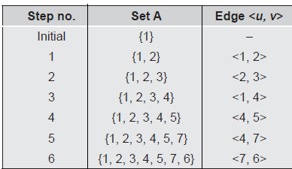
Prim’s Algorithm
Cost = 0
Cost = cost + weight of added edge

Slide 82
Prim’s Algorithm
Cost = 177

Slide 83
Complete Graph
Start vertex - A
4
4
B
C
2
1
A
4
E
1
F
D
2
3
10
5
G
5
6
3
4
I
H
2
3
J

Slide 84
Old Graph
New Graph
Possibilities
Selection
4
4
4
B
C
4
B
C
2
1
2
1
A
1
4
E
A
4
F
1
E
F
D
2
3
2
10
D
3
G
5
10
G
5
5
6
3
5
6
3
4
I
4
H
I
3
H
2
J
3
2
J

Slide 85
Possibilities from added edge <A,D>
4
B
4
C
B
C
4
4
2
2
1
1
A
4
E
A
1
4
E
1
F
F
D
2
3
D
2
3
10
10
G
5
G
5
5
6
3
5
6
3
4
4
I
I
H
H
3
3
2
J
2
J

Slide 86
Possibilities from added edge <A,D> and <A,B>
New Graph
4
4
B
C
4
B
C
4
2
1
2
1
A
4
E
A
4
E
1
F
1
F
D
2
3
2
D
10
3
10
G
5
5
G
5
6
3
5
6
3
4
I
4
H
I
3
H
2
J
3
2
J

Slide 87
Possibilities from added edge <A,D> <A,B> and <B,C>
New Graph
4
4
4
B
C
4
B
C
2
1
2
1
A
1
4
E
A
4
F
1
E
F
D
2
3
2
10
D
3
G
5
10
G
5
5
6
3
5
6
3
4
I
4
H
I
3
H
2
J
3
2
J

Slide 88
Possibilities from added edge <A,D> <A,B> <B,C> and <C,F>
New Graph
4
B
C
4
4
4
B
C
2
1
2
1
A
4
E
1
F
A
4
E
1
F
D
2
3
10
D
2
3
G
5
10
G
5
5
6
3
5
6
3
4
I
4
H
I
3
H
2
J
2
3
J

Slide 89
Possibilities from added edge <A,D> <A,B> <B,C> <C,F> and <C,E>
New Graph
4
4
4
B
C
4
B
C
2
1
2
1
A
4
E
A
4
1
F
1
E
F
D
2
2
3
D
3
10
10
G
5
5
G
5
6
3
5
6
3
4
I
4
H
I
3
H
2
J
2
3
J

Slide 90
Possibilities from added edge <A,D> <A,B> <B,C> <C,F> <C,E> and <E,G>
New Graph
4
4
4
B
C
4
B
C
2
1
2
1
A
1
4
E
A
4
F
1
E
F
D
2
3
2
10
D
3
G
5
10
G
5
5
6
3
5
6
3
4
I
4
H
I
3
H
2
J
3
2
J

Slide 91
Possibilities from added edge <A,D> <A,B> <B,C> <C,F> <C,E> <E,G> and <G,I>
New Graph
4
4
4
B
C
B
C
4
2
1
2
1
A
4
E
1
F
A
4
E
1
F
D
2
2
10
3
D
3
G
5
10
G
5
5
6
3
5
6
3
4
I
4
H
I
3
H
2
J
3
2
J

Slide 92
Possibilities from added edge <A,D> <A,B> <B,C> <C,F> <C,E> <E,G> <G,I> and <I,J>
New Graph
4
4
B
C
4
4
B
C
2
1
2
1
A
4
E
1
F
A
4
1
E
F
D
2
3
10
D
2
3
G
5
10
G
5
5
6
3
5
6
3
4
I
4
H
I
3
H
2
J
3
2
J

Slide 93
Complete Graph
Minimum Spanning Tree
B
4
C
4
4
4
B
C
2
1
2
1
A
4
E
1
F
A
E
F
1
D
2
3
10
D
2
G
5
G
5
6
3
3
4
I
H
I
3
H
2
J
3
2
J

Slide 94
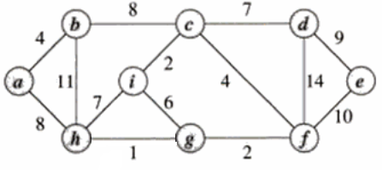
Prim’s and Kruskal’s Example
Prim’s
Termination – All vertices are included in MST
Cost = 37
Kruskal’s
Termination – #edges in MST < #vertices
Cost = 37

Slide 95
Time Complexity
Prim’s:-
For implementation O(n²) - Dense graph
Kruskal’s:-
For sorting edges O(E log E)
For merging of components O(log V)
Overall O(E log E) + O(log V) i.e. O(E log V)
MST Application – Network design so that only the minimum number of packets need to be relayed across the network and multiple copies of the same packet don't arrive via different paths.

Slide 96
Shortest Path Algorithm
Objective
Find the shortest path between any two vertices in the graph. OR
Find the shortest path from given starting vertex to every other vertex .
The shortest path between two given vertices is the path having minimum length.
Greedy Algorithm - Dijkstra’s algorithm (Edger W. Dijkstra)
For any graph G=(V,E,w);
Distance hold the length of the shortest distance.
Path hold the shortest path between the source and each of the vertices.

Slide 97
Single Source Shortest Path Algorithm
For a weighted graph G = (V, E, w); the single-source shortest paths problem is to find the shortest paths from a vertex v ∈ V to all other vertices in V.
Dijkstra's algorithm is similar to Prim's algorithm. It maintains a set of adjacent nodes for which the shortest paths are known.
For any edge <u,v>;
dist[v] = min{ dist[v], dist[u] + weight(u, v) }

Slide 98
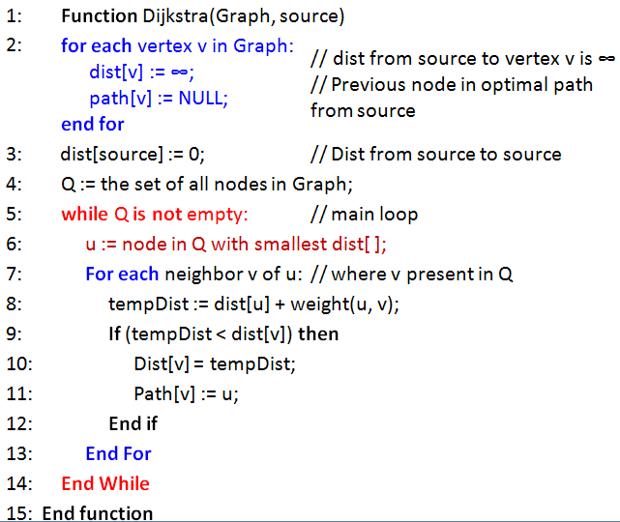
Dijkstra's Shortest Path Algorithm

Slide 99
Dijkstra's Shortest Path Algorithm

Slide 100
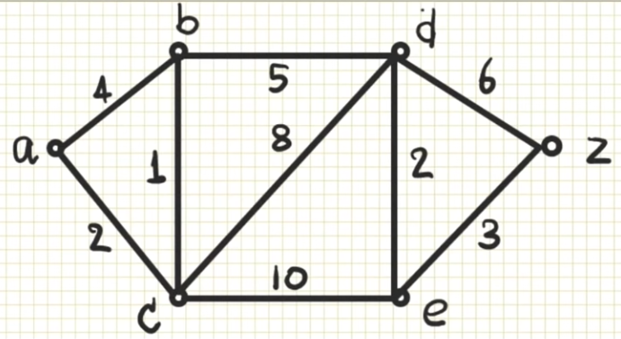
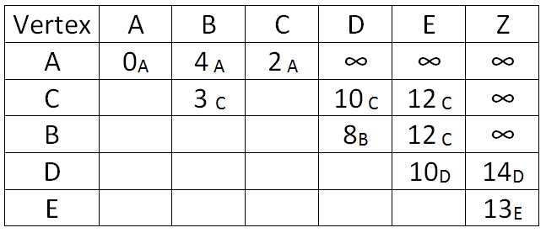
Dijkstra's Shortest Path Algorithm
Minimum weight is 2 i.e. vertex C
Dist(B)
= min(4, <ACB>)
= min(4, <2+1>)
= min(4, 3)
= 3

Slide 101
Dijkstra's Shortest Path Algorithm
Shortest Path -
A
C
B
D
E
Z
Start vertex – a
Destination vertex - z

Slide 102
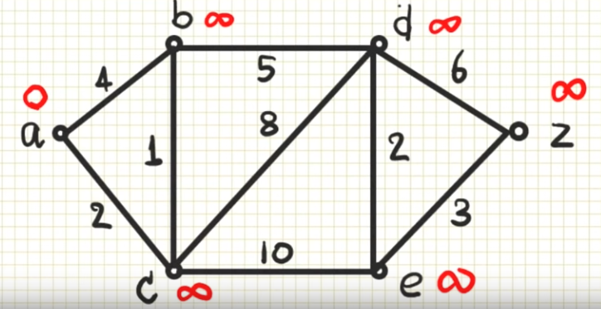
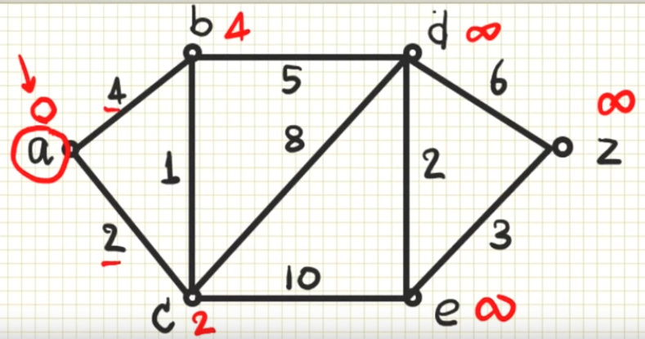
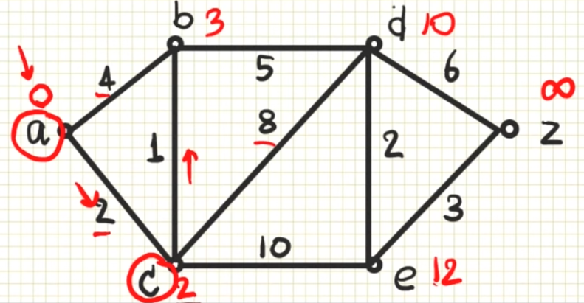
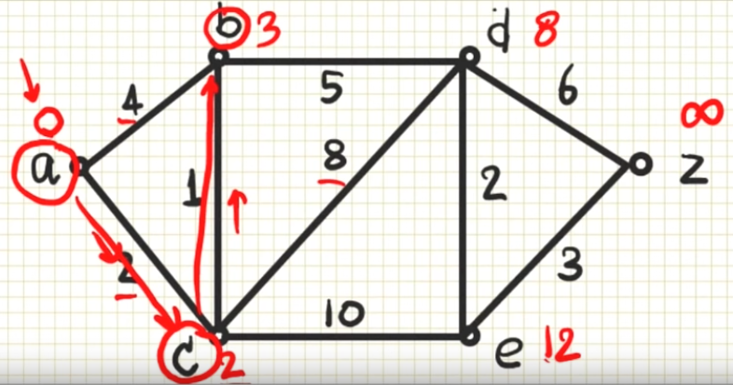
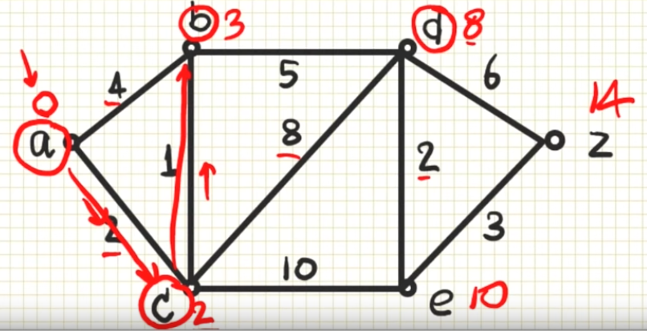

Slide 103
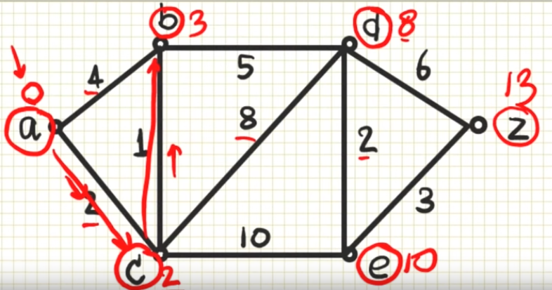

Slide 104


Dijkstra's Shortest Path Algorithm
Start vertex – A
Destination vertex - H
Path

Slide 105
Dijkstra's Shortest Path Algorithm
Path
A C D E G F H
Cost - 11

Slide 106

Dijkstra's Shortest Path Algorithm (Alternate selection)

Slide 107
Dijkstra's Shortest Path Algorithm
Path
A C D E G F H
Cost - 11

Slide 108



Dijkstra’s shortest Path
Start vertex – a
Destination vertex - d
A to every other vertex

Slide 109

Start vertex – a
Destination vertex - d
A to every other vertex

Slide 110
Dijkstra's Shortest Path Algorithm
Find shortest path from s to t.
2
24
3
9
s
18
14
6
6
2
30
4
19
15
11
5
5
6
20
16
7
t
44

Slide 111
Dijkstra's Shortest Path Algorithm
S = { }
PQ = { s, 2, 3, 4, 5, 6, 7, t }
∞
∞
2
24
3
0
9
s
∞
18
14
6
6
2
∞
30
∞
4
19
11
15
5
5
6
20
16
7
t
44
∞
∞

Slide 112
Dijkstra's Shortest Path Algorithm
S = { }
PQ = { s, 2, 3, 4, 5, 6, 7, t }
delmin
∞
∞
2
24
3
0
9
s
∞
18
14
6
6
2
∞
30
∞
4
19
11
15
5
5
6
20
16
7
t
44
∞
∞

Slide 113
Dijkstra's Shortest Path Algorithm
S = { s }
PQ = { 2, 3, 4, 5, 6, 7, t }
decrease key
∞
∞
9
X
2
24
3
0
9
s
∞
14
18
14
X
6
6
2
∞
30
∞
4
19
11
15
5
5
6
20
16
7
t
44
∞
15
∞
X

Slide 114
Dijkstra's Shortest Path Algorithm
S = { s }
PQ = { 2, 3, 4, 5, 6, 7, t }
delmin
∞
∞
9
X
2
24
3
0
9
s
∞
14
18
14
X
6
6
2
∞
30
∞
4
19
11
15
5
5
6
20
16
7
t
44
∞
15
∞
X

Slide 115
Dijkstra's Shortest Path Algorithm
S = { s, 2 }
PQ = { 3, 4, 5, 6, 7, t }
∞
∞
9
X
2
24
3
0
9
s
∞
14
18
14
X
6
6
2
∞
30
∞
4
19
11
15
5
5
6
20
16
7
t
44
∞
15
∞
X

Slide 116
Dijkstra's Shortest Path Algorithm
S = { s, 2 }
PQ = { 3, 4, 5, 6, 7, t }
decrease key
∞
33
∞
X
9
X
2
24
3
0
9
s
∞
14
18
14
X
6
6
2
∞
30
∞
4
19
11
15
5
5
6
20
16
7
t
44
∞
15
∞
X

Slide 117
Dijkstra's Shortest Path Algorithm
S = { s, 2 }
PQ = { 3, 4, 5, 6, 7, t }
∞
33
∞
X
9
X
2
24
3
0
9
delmin
s
∞
14
18
14
X
6
6
2
∞
30
∞
4
19
11
15
5
5
6
20
16
7
t
44
∞
15
∞
X

Slide 118
Dijkstra's Shortest Path Algorithm
S = { s, 2, 6 }
PQ = { 3, 4, 5, 7, t }
32
∞
33
∞
X
X
9
X
2
24
3
0
9
s
∞
14
18
14
X
6
6
2
44
∞
∞
4
30
X
19
11
15
5
5
6
20
16
7
t
44
∞
15
∞
X

Slide 119
Dijkstra's Shortest Path Algorithm
S = { s, 2, 6 }
PQ = { 3, 4, 5, 7, t }
32
∞
33
∞
X
X
9
X
2
24
3
0
9
s
∞
14
18
14
X
6
6
2
44
∞
∞
4
30
X
19
11
15
5
5
6
20
16
7
t
44
∞
15
delmin
∞
X

Slide 120
Dijkstra's Shortest Path Algorithm
S = { s, 2, 6, 7 }
PQ = { 3, 4, 5, t }
32
∞
33
∞
X
X
9
X
2
24
3
0
9
s
∞
14
18
14
X
6
6
2
44
35
∞
X
∞
4
30
X
19
11
15
5
5
6
20
16
7
t
44
59
∞
∞
15
X
X

Slide 121
Dijkstra's Shortest Path Algorithm
S = { s, 2, 6, 7 }
PQ = { 3, 4, 5, t }
delmin
32
∞
33
∞
X
X
9
X
2
24
3
0
9
s
∞
14
18
14
X
6
6
2
44
35
∞
X
∞
4
30
X
19
11
15
5
5
6
20
16
7
t
44
59
∞
∞
15
X
X

Slide 122
Dijkstra's Shortest Path Algorithm
S = { s, 2, 3, 6, 7 }
PQ = { 4, 5, t }
32
∞
33
∞
X
X
9
X
2
24
3
0
9
s
∞
14
18
14
X
6
6
2
44
35
34
∞
X
X
∞
4
30
X
19
11
15
5
5
6
20
16
7
t
44
51
59
∞
∞
15
X
X
X

Slide 123
Dijkstra's Shortest Path Algorithm
S = { s, 2, 3, 6, 7 }
PQ = { 4, 5, t }
32
∞
33
∞
X
X
9
X
2
24
3
0
9
s
∞
14
18
14
X
6
6
2
44
35
34
∞
X
X
∞
4
30
X
19
11
15
5
5
6
20
delmin
16
7
t
44
51
59
∞
∞
15
X
X
X

Slide 124
Dijkstra's Shortest Path Algorithm
S = { s, 2, 3, 5, 6, 7 }
PQ = { 4, t }
32
∞
33
∞
X
X
9
X
2
24
3
0
9
s
∞
14
18
14
X
6
6
2
35
34
45
∞
44
X
X
X
∞
4
30
X
19
11
15
5
5
6
20
16
7
t
44
50
51
59
∞
∞
15
X
X
X
X

Slide 125
Dijkstra's Shortest Path Algorithm
S = { s, 2, 3, 5, 6, 7 }
PQ = { 4, t }
32
∞
33
∞
X
X
9
X
2
24
3
0
9
s
∞
14
18
14
X
6
6
2
35
34
45
∞
44
X
X
X
∞
4
30
X
19
11
15
5
delmin
5
6
20
16
7
t
44
50
51
59
∞
∞
15
X
X
X
X

Slide 126
Dijkstra's Shortest Path Algorithm
S = { s, 2, 3, 4, 5, 6, 7 }
PQ = { t }
32
∞
33
∞
X
X
9
X
2
24
3
0
9
s
∞
14
18
14
X
6
6
2
35
34
45
∞
44
X
X
X
∞
4
30
X
19
11
15
5
5
6
20
16
7
t
44
50
51
59
∞
∞
15
X
X
X
X

Slide 127
Dijkstra's Shortest Path Algorithm
S = { s, 2, 3, 4, 5, 6, 7 }
PQ = { t }
32
∞
33
∞
X
X
9
X
2
24
3
0
9
s
∞
14
18
14
X
6
6
2
35
34
45
∞
44
X
X
X
∞
4
30
X
19
11
15
5
5
6
20
16
7
t
44
delmin
50
51
59
∞
∞
15
X
X
X
X

Slide 128
Dijkstra's Shortest Path Algorithm
S = { s, 2, 3, 4, 5, 6, 7, t }
PQ = { }
32
∞
33
∞
X
X
9
X
2
24
3
0
9
s
∞
14
18
14
X
6
6
2
35
34
45
∞
44
X
X
X
∞
4
30
X
19
11
15
5
5
6
20
16
7
t
44
50
51
59
∞
∞
15
X
X
X
X

Slide 129
Dijkstra's Shortest Path Algorithm
S = { s, 2, 3, 4, 5, 6, 7, t }
PQ = { }
32
∞
33
∞
X
X
9
X
2
24
3
0
9
s
∞
14
18
14
X
6
6
2
35
34
45
∞
44
X
X
X
∞
4
30
X
19
11
15
5
5
6
20
16
7
t
44
50
51
59
∞
∞
15
X
X
X
X

Slide 130
Time Complexity
Dijkstra’s:-
For adjacency matrix implementation O(n²)
For adjacency list – O(E log V)

Slide 131


Topological Sorting/Ordering
For any directed acyclic graph (DAG) G(V,E)- topological sorting is linear ordering of all its vertices such that if G contains an edge <u,v> then u appears before v in the ordering.
A B C D E
A C B D E
Ordering can be viewed as list of vertices along a horizontal line so that all directed edges go from left to right.

Slide 132



Topological Sorting
Applications-
Planning of sequence/task,
Task scheduling,
Project deadlines,
Pre-requisite problems (University courses),
Build projects (Dependant libraries)

Slide 133

Topological Sorting
Topological sort is not unique.
Following are all topological sort of the graph below:
s1 = {a, b, c, d, e, f, g, h, i}
s2 = {a, c, b, f, e, d, h, g, i}
s3 = {a, b, d, c, e, g, f, h, i}
s4 = {a, c, f, b, e, h, d, g, i}
etc.
The Source Removal Topological sort algorithm is:
Pick a source a [vertex with in-degree zero], output it.
Remove a and all edges out of a.
Repeat until graph is empty.

Slide 134

Topological Sorting
Topological-sort(G)
Call DFS(G)
As each vertex is finished (i.e. no more adjacent or unvisited vertex), add it onto the front of topological sorted list.
Adjacency List

Slide 135
Topological Sorting
Call DFS (G)
As each vertex is finished add it onto the front of topological sorted list.
DFS
a
b
d
g
i
c
f
h
e
Adjacency List
Vertex i is finished; as no further adjacent & unvisited vertices
f
h
Vertex g, d are also finished.
i
g
Vertex h, f, c are finished.
d
Vertex e is finished.
b
Vertex b, a are finished.
c
e
Topological Order
a
a b e c f h d g i

Slide 136
Topological Sorting
Adjacency List
Topological Order
a b e c f h d g i

Slide 137
Topological Ordering - complexity
O(V + E) for DFS and O(1) time for adding vertex to the list
O(V + E) for Topological ordering
V are the vertices
E are the edges
Same as DFS

Slide 138
Revision
Graphs
Directed, weighted, dense, sparse
Storage representation
Adjacency matrix
Adjacency list, adjacency multi list, inverse adjacency list.
Traversals-
Depth first search (Stack)
Breadth first search (Queue)
Greedy Strategy
Minimum spanning Tree
Prim’s Algorithm (start vertex and then keep adding minimum value edge)
Kruskal’s Algorithms – on sorted edges
Dikjtra's Single Source shortest path
Topological ordering.

Slide 139

Quiz
What is the number of edges present in a complete graph having n vertices? a) (n*(n+1))/2
b) (n*(n-1))/2
c) n
d) Information given is insufficient
Dijkstra’s Algorithm will work for both negative and positive weights?
a) True
b) False
What would be the DFS traversal of the given Graph?
a) ADEBC
b) AEDCB
c) EDCBA
d) ACEDB

Slide 140
Quiz
Which of the following is/are the operations performed by kruskal’s algorithm?
sort the edges of G in increasing order by length
keep a subgraph S of G initially empty
builds a tree one vertex at a time
A) i, and ii only
B) ii and iii only
C) i and iii only
D) All i, ii and iii
Rather than build a subgraph one edge at a time …………………………. builds a tree one vertex at a time.
A) Kruskal’s algorithm
B) Prim’s algorithm
C) Dijkstra algorithm
D) topological order

Slide 141
Quiz
……………… is known as a greedy algorithm, because it chooses at each step the cheapest edge to add to subgraph S.
A) Kruskal’s algorithm
B) Prim’s algorithm
C) Dijkstra algorithm
D) Bellman ford algorithm
Dijkstra’s Algorithm is also called the …………………. shortest path problem. A) multiple source
B) single source
C) single destination
D) multiple destination
In …………… input is a directed acyclic graph (DAG)G=(V,E).
A) Graph transpose problem
B) Strongly connected components problem
C) Topological sort problem
D) Euler path problem

Slide 142

Quiz
What are the appropriate data structures for following algorithms?
Breadth First Search
Depth First Search
Prim’s Minimum Spanning Tree
Kruskal’s Minimum Spanning Tree
A) Stack, Queue, Priority Queue, Union-Find
B) Queue, Stack, Priority Queue, Union-Find
C) Stack, Queue, Union-Find, Priority Queue
D) Priority Queue, Queue, Stack, Union-Find
Prim’s can use Priority Q for holding vertices not included in MST
Kruskal’s use Union-Find algorithm to find smallest edge & add it to MST(incremental connection).
The Breadth First Search algorithm has been implemented using the queue data structure. One possible order of visiting the nodes of the following graph is
a) MNOPQR
b) NQMPOR
c) QMNPRO
d) QMNPOR

